Slide 1
Big Data
BDM- 1034

Slide 2

Hello!
I am Teresa Zhu
E-mail
-teresaz@queenscollege.ca

Slide 3
Week 1
Introduction to Big Data

Slide 4
Data is life. Data is process.

Slide 5
Data is the key to:
understanding exactly what happened
making better decisions
competitiveness
artificial intelligence
digital transformation

Slide 6
What gave rise to big data?
increasing data volumes
higher-powered compute
much cheaper storage
open source technology
cloud
self perpeturating: better analytics begets more data which begets more and better analytics
AI

Slide 7
The 3 V
volume
velocity
variety

Slide 8
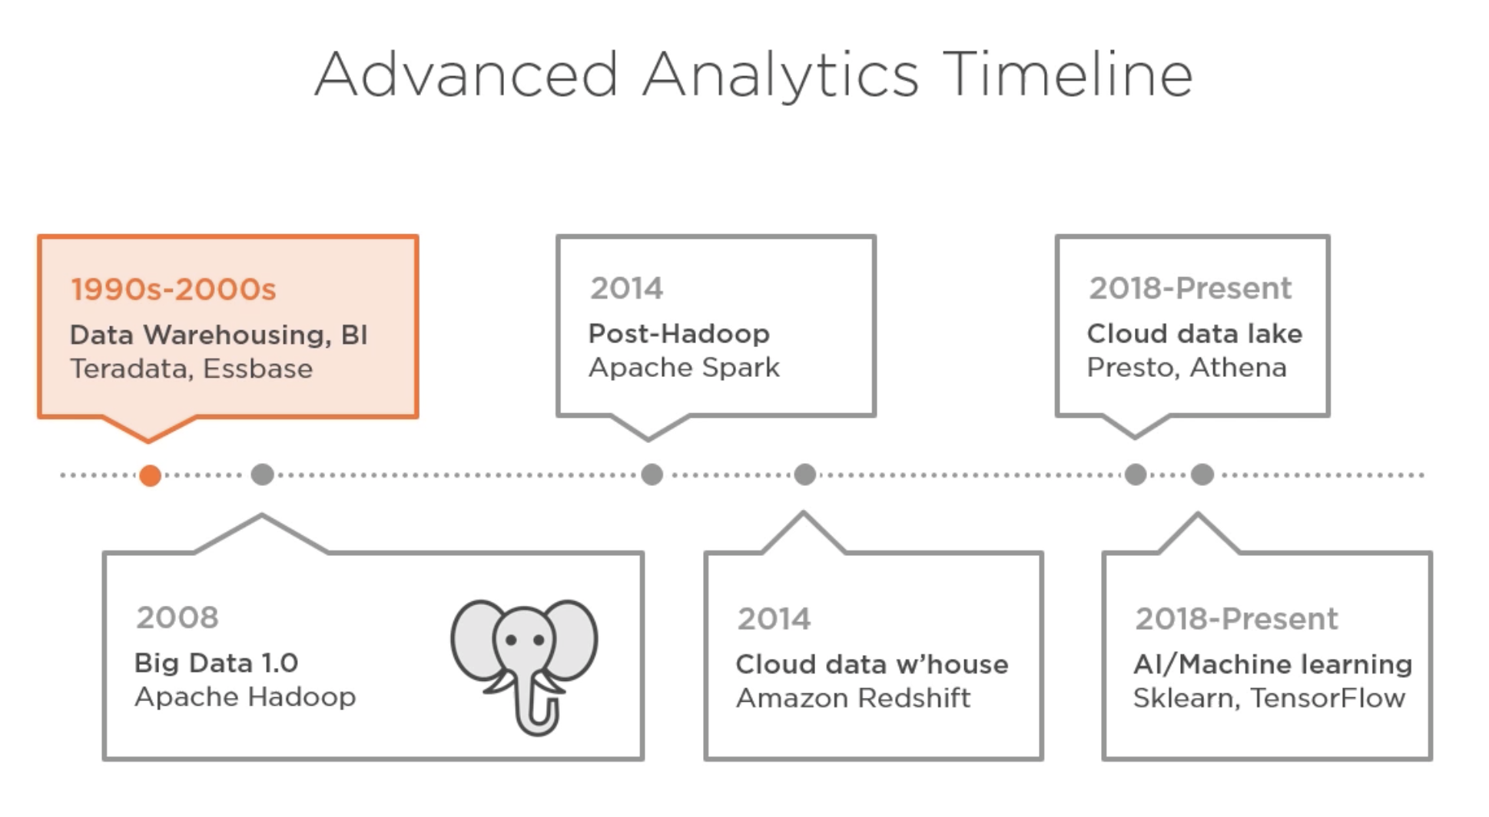

Slide 9
Professional roles in big data
analyst
data engineer
data steward
data scientist
machine learning engineer
chief data / analytics / data and analytics officer

